Slide 1

EXECUTIVE SUMMARY
Ustacky Data Science Microdegree Program
Analyze Supermarket Data Across the Country - Company XYZ
OKEOWO TUNDE SAMUEL

Slide 2

INTRODUCTION
Ustacky Data Science Microdegree Program
PROBLEM STATEMENT
Company XYZ owns a supermarket chain across the country. Each major branch located in Lagos, Abuja and Port Harcout recorded sales information for 3 months (Between January 2019 and March 2019)
Rise of supermarkets competition is seen to increase

Slide 3
Ustacky Data Science Microdegree Program
PURPOSE STATEMENT
To help the company understand sales trends and determine its growth, as the rise of supermarkets competition is seen to increase.

Slide 4

Ustacky Data Science Microdegree Program
Results from this analysis can be used by the company to make better decisions and help position them at an advantage against their competitors.

Slide 5
Ustacky Data Science Microdegree Capstone Project
PROJECT SUMMARY
Questions answered in this project are:
What are the Unique Hours of sales and the most frequent Hours of Sales.
What City has the highest sales record
Which Customer type has the highest purchase record
Which Gender has the highest purchase record
Which Product Line has the highest Purchase record
What is the most frequent payment method

Slide 6
Ustacky Data Science Microdegree Program
More Questions:
Which City has the Highest Total Gross Income
Which Branch or City has the Highest Customer Rating
What is the relationship between Unit Price of Goods and Quantity Purchased
What is the relationship between Gender and Unit Price of Goods Purchased
What is the relationship between Gender and Quantity of Goods Purchased
Which Product Line produces the highest Gross income
What is the relationship between Hour of sale and Gross income

Slide 7
Ustacky Data Science Microdegree Program
DATA OVERVIEW AND EXPLORATION
Files (csv) containing sales record of each branch of company-xyz was loaded automatically from the directory and concatenated using the pd.concat() function into a single dataframe.
The data was then explored to get basic information about the data such as:
The Shape of dataframe using df.shape
The Columns in dataframe using df.columns
The statistical summary of quantitative variables in dataframe using df.describe()
The presence of missing values using df.isnull() or df.notna()
Other infomation about dataframe using df.info()

Slide 8

Ustacky Data Science Microdegree Program
DATA PREPROCESSING
The Pre-processing task carried out in this project include:
Formatting Date column to datetime datatype using pd.to_datetime()
Extraction of Day, month and Year from the Date column and saving to new columns of Day, Month and Year respectively
Formatting Time column to datetime datatype using pd.to_datetime()
Extraction of Hour from Time column and saving to new Hour column

Slide 9
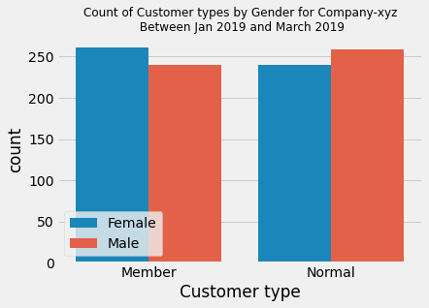
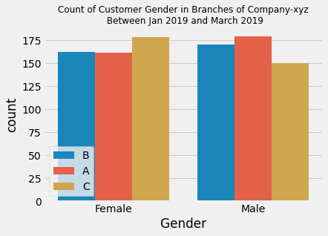
Ustacky Data Science Microdegree Program
ANALYSIS AND INSIGHT
There are more female customer with
Membership while there are more male Customers without membership i.e. Normal
Port Harcourt City has the highest female Customers
While Lagos City has the highest male customers

Slide 10
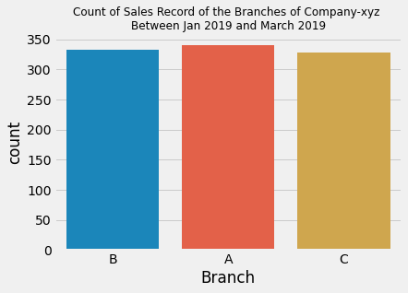
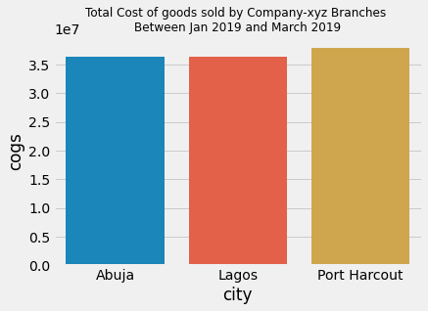
Ustacky Data Science Microdegree Program
Lagos City has the highest
Sales record.
Port Harcourt City has the highest cost of goods sold

Slide 11
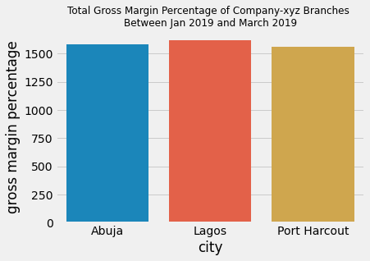
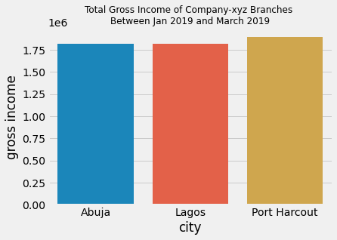
Ustacky Data Science Microdegree Capstone Project
Lagos City has the highest Gross
Margin Percentage.
Port Harcourt City has the highest Gross Income

Slide 12
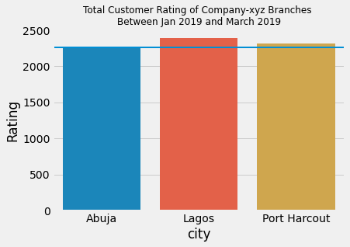
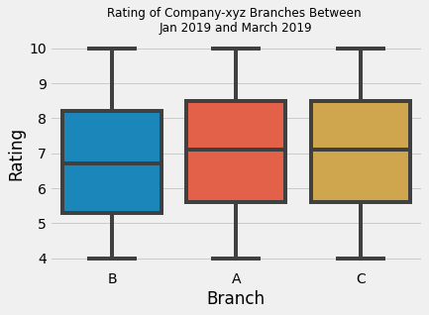
Ustacky Data Science Microdegree Program
Lagos City has the highest
Total Customer rating
Port Harcourt City has the Highest Mean Customer
Rating i.e. rating per customer, about 7.07 per customer
Abuja City has the lowest mean and total Customer rating.

Slide 13
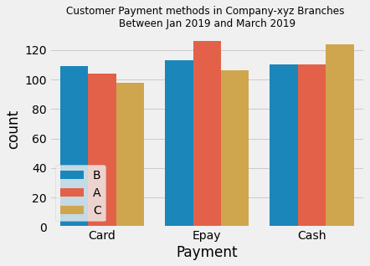
Ustacky Data Science Microdegree Program
Cash Payment is the most frequent payment method in Port Harcourt City
E-pay is the most frequent payment method in Lagos City
Card Payment is the most frequent payment method in Abuja City

Slide 14
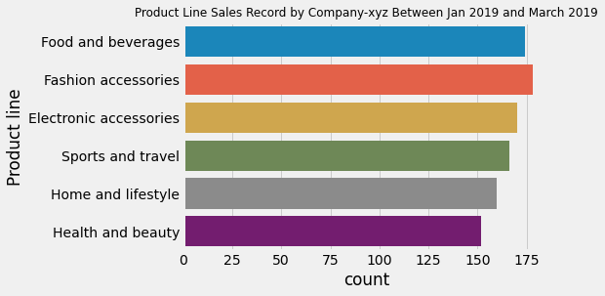
Ustacky Data Science Microdegree Program
The Most sold Product line in company-xyz is Fashion Accessories followed by Food
And Beverages.

Slide 15
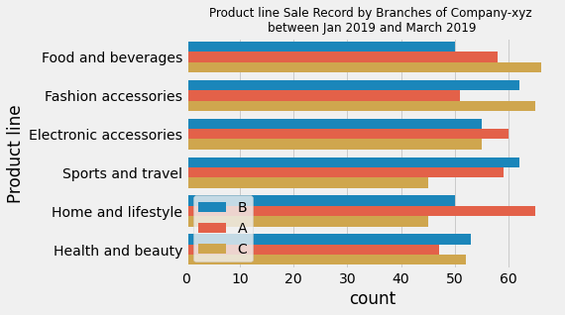
Ustacky Data Science Microdegree Program
The most sold product line in Port Harcourt City is Food and Beverages, followed by Fashion accessories and its sales is higher than those of Lagos and Abuja
The most sold Product line in Lagos is Home and Lifestyle, and Electronic accessories and its sales is higher than those of Port Harcourt and Abuja
The three most sold product line in Abuja are Sports and travel, Fashion accessories, and Health and Beauty.

Slide 16
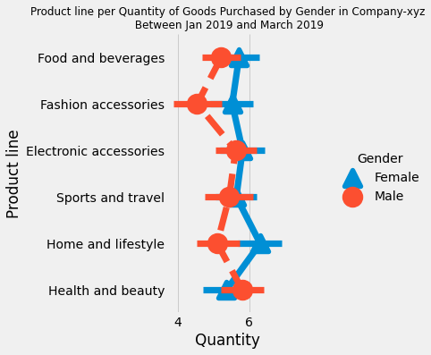
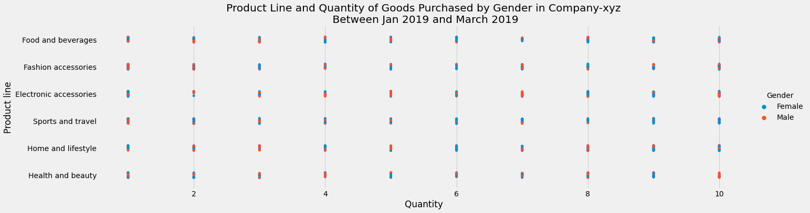
Ustacky Data Science Microdegree Program
The female customers purchased the most
Quantity of Product Lines except for Health
and Beauty products

Slide 17
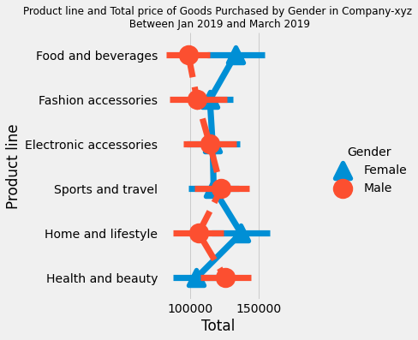
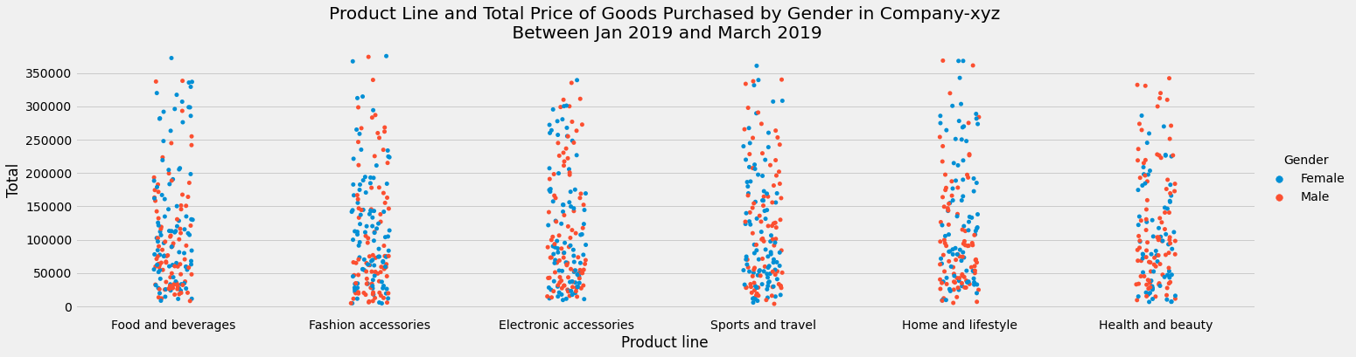
Ustacky Data Science Microdegree Program
Female customers purchased the highest
total goods for Food and Beverages, Fashion
and accessories and Home and lifestyle.
Male customers purchased the highest total
goods for Sports and Travel and Health and
Beauty.

Slide 18
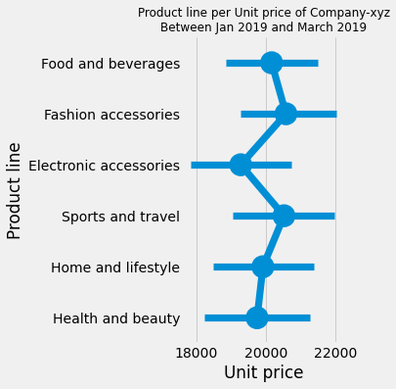
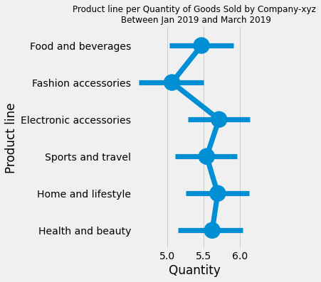
Ustacky Data Science Microdegree Program
Interaction Between Unit Price and Quantity of Goods Purchased
Quantity of goods sold is inversely related to unit price
Quantity of product line sold decreases with higher unit prices

Slide 19
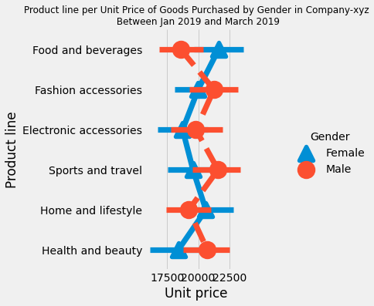
Ustacky Data Science Microdegree Program
Interaction Between Gender, Unit Price and Quantity of Goods Purchased
The male Customers bought more Product line with higher unit prices but less quantity of it.
The female Customers bought less Product line with higher unit prices but more quantity of it.

Slide 20
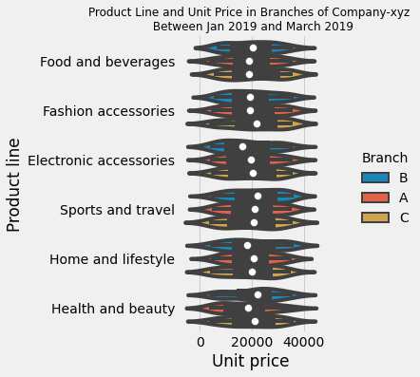
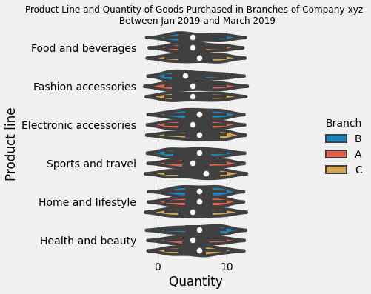
Ustacky Data Science Microdegree Program
Interaction Between Unit Price and Quantity of Product line sold
in branches of company-xyz
Relationship shows the same Inverse relationship, Quantity of goods Purchased
in Branches of company-xyz reduces with increasing unit price.

Slide 21
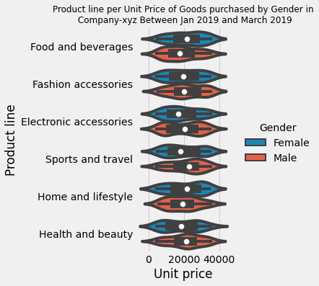
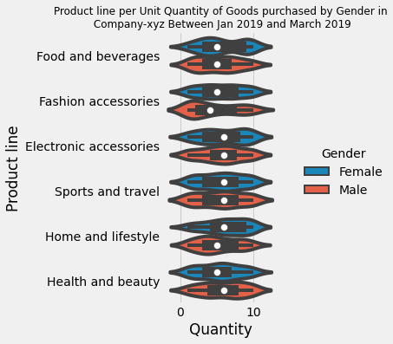
Ustacky Data Science Microdegree Program
Interaction Between Gender Unit Price and Quantity of Product line sold in company-xyz

Slide 22
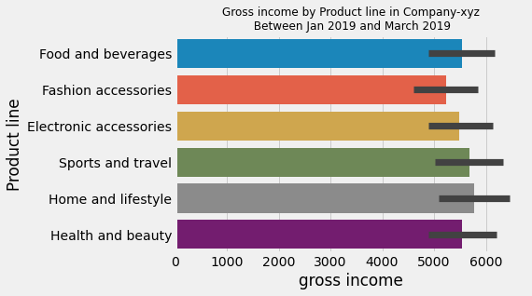
Ustacky Data Science Microdegree Program
Contribution of Product line to Company-xyz Gross Income
Home and Lifestyle Contributed the most to the gross income of company xyz
Followed by Sports and Travel, and Food and Beverages.
Fashion Accessories contributed the least to the gross income of company-xyz

Slide 23
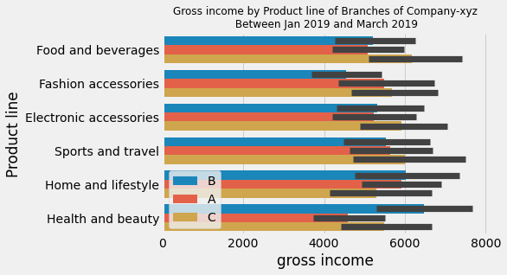
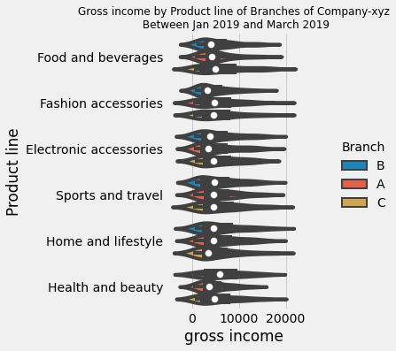
Ustacky Data Science Microdegree Program
Contribution of Product line to Branches of Company-xyz Gross Income
Food and beverages, Fashion and Electronic accessories, and Sports and
travel contributed largely to Port Harcourt City Gross income.
Health and Beauty , and Home and Lifestyle contributed the most to Abuja City Gross income
Lagos City has fairly equal contributions from all product lines except for
Health and Beauty product with the least contribution.

Slide 24
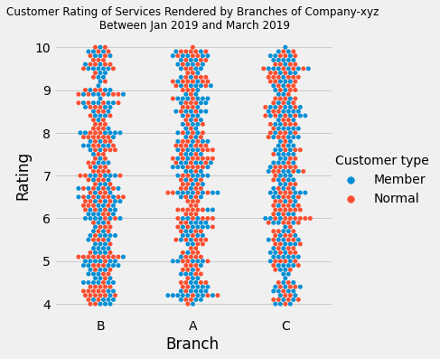
Ustacky Data Science Microdegree Program
Interaction Between Customer type and Rating in Branches of Company-xyz

Slide 25
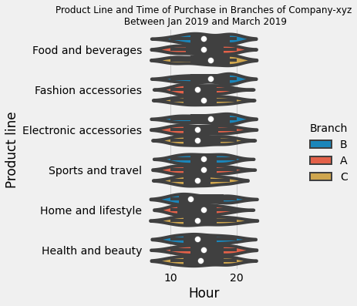
Ustacky Data Science Microdegree Program
Average time of Purchase of Product line in Branches of Company-xyz

Slide 26
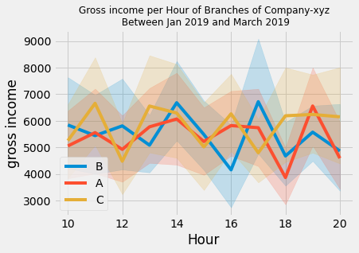
Ustacky Data Science Microdegree Program
The gross income of Port Harcourt City has multiple peaks at 11, 13, 16, 18-20 Hour
The gross income of Abuja City is maximum at 14 and 17 Hour
The gross income of Lagos City is fairly constant and maximum at 19 Hour

Slide 27
Ustacky Data Science Microdegree Program
SUMMARY AND CONCLUSION
There are many Female customers than male customer in Company XYZ
Female customers have the highest quantity of purchase than male
Port Harcourt City with the highest female customers recorded the highest Gross Income for company XYZ
Gender has a significant effect on the Product line sold in company XYZ

Slide 28
Ustacky Data Science Microdegree Program
SUMMARY AND CONCLUSION
The Product line that contributed to the Highest Gross income of company XYZ
are Home and lifestyle Products (Gender-based).
Male customers are the most buyers of product line with high unit price but
purchase lesser quantity, hence contributing less to the overall cost of goods
sold (cogs)
The customer rating may have an effect on the gross income of company XYZ
Port Harcourt with the highest mean rating has the highest gross income.
Abuja with the least mean rating has the least gross income.

Slide 29
Ustacky Data Science Microdegree Program
RECOMMENDATION
Customer Satisfaction is key to high rating and should be improved in Abuja City Branch
In other to improve sales recorded
Significant attention should be paid to increasing female to male ratio of customers in
all the branches of company XYZ especially Abuja and Lagos
Finally Significant attention should be paid to increasing Member to Normal ratio of customer
types in all branches of company XYZ.

Slide 30
Ustacky Data Science Microdegree Program
FUTURE WORKS
Future work will be to divide the dataframe into three parts based on hours:
* df_early for sales between 10 - 13 Hour,
* df_mid for sales between 14-16 Hour
* df_late for sales between 17-20 Hour
All the Analysis carried out in this project will then be repeated for these three dataframes
This will help to uncover various relationships already seen in this current project in a temporal manner

Slide 31

Ustacky Data Science Microdegree Program

Slide 32
References
https://docs.google.com/document/d/1Sv-DlynHpOBAs5qKokn5MtbzqZcumTSlSI4-wQ0kf0w/edit

